Slide 1
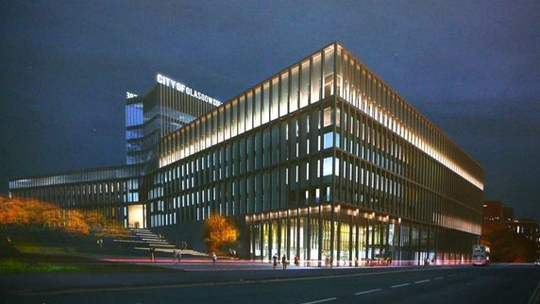
Circular Economy
& the Construction
Sector

Slide 2
The Circular Economy
Summary
Session 1 (20 mins) - ‘Introduction to the Circular Economy’
Session 2 (20 mins) - ‘Construction and the Circular Economy’
Session 3 (20mins) - ‘The Circular Economy and How we do Business’
- break -
Workshop (1 hr) - Exploration of Examples / Case Studies / Summary
Circular Economy
and the Construction Sector
Notes:
This is a summary of the Circular Economy Session we have just undertaken. It’s aims were:
To firstly introduce the topic of CE from first principles.
To illustrate the importance of CE in the construction industry, now and in the future.
To highlight some of the existing examples of CE in construction.
To encourage lecturing staff to think actively about how to incorporate CE into the units they teach and the wider curriculum.
To motivate and inspire the audience on the subject of CE.

Slide 3
Application in Further
Education

Slide 4
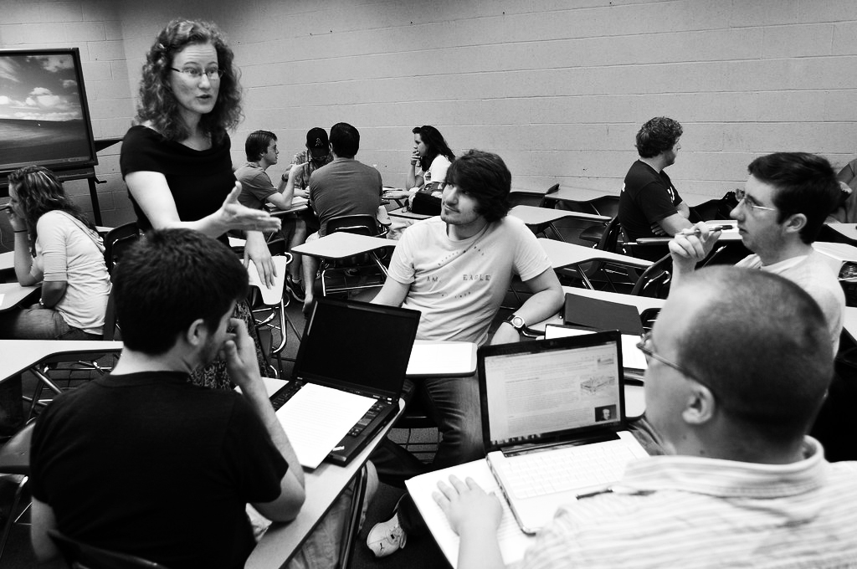
Application in Further Education
What Can You Do?
The challenge for us now in Further Education is to consider how we can incorporate Circular Economy principles in what we teach.
Can this be incorporated into the units you teach?
What opportunities does it provide in / outwith the classroom?
Circular Economy
and the Construction Sector
Notes:
What Can You Do?
The challenge for us now in Further Education is to consider how we can incorporate Circular Economy principles in what we teach.
Can this be incorporated into the units you teach? Discuss.
What opportunities does it provide in / outwith the classroom? Discuss.

Slide 5
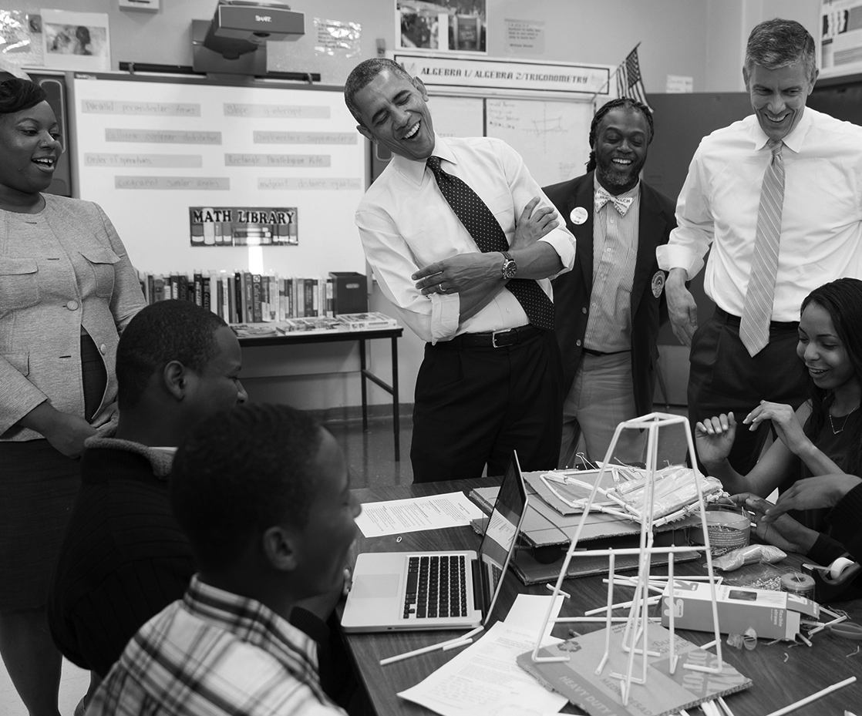
Application in Further Education
Summary of Learning Outcomes
Understand the two opposing concepts of the linear economy and the circular economy.
Be able to describe the linkage between climate change, energy efficiency, renewable energy and the circular economy.
Recognise that the construction sector has the greatest potential to reduce our need for primary material resources.
Be able to explain the concept of a waste hierarchy and how it can be used to prioritise waste management.
Circular Economy
and the Construction Sector
Notes:
Summary of Learning Outcomes
Understand the two opposing concepts of the linear economy and the circular economy.
Be able to describe the linkage between climate change, energy efficiency, renewable energy and the circular economy.
Recognise that the construction sector has the greatest potential to reduce our need for primary material resources.
Be able to explain the concept of a waste hierarchy and how it can be used to prioritise waste management.

Slide 6
Application in Further Education
Summary of Learning Outcomes…
Have an understanding of the tools which can assist in reduce reuse recycle in the construction sector
Be able to recognise the importance of collaboration at an early stage in the build process
Have an understanding of the ultimate impact of the current linear economy on Resource Scarcity and Mounting Waste.
Be able to Identify 2 Schools of Thinking in relation to Circular Economy Business Models
Give examples of precedents for different Circular Business models within the Construction Sector.
Circular Economy
and the Construction Sector
Notes:
Have an understanding of the tools which can assist in reduce reuse recycle in the construction sector
Be able to recognise the importance of collaboration at an early stage in the build process
Have an understanding of the ultimate impact of the current linear economy on Resource Scarcity and Mounting Waste.
Be able to Identify 2 Schools of Thinking in relation to Circular Economy Business Models
Give examples of precedents for different Circular Business models within the Construction Sector.

Slide 7
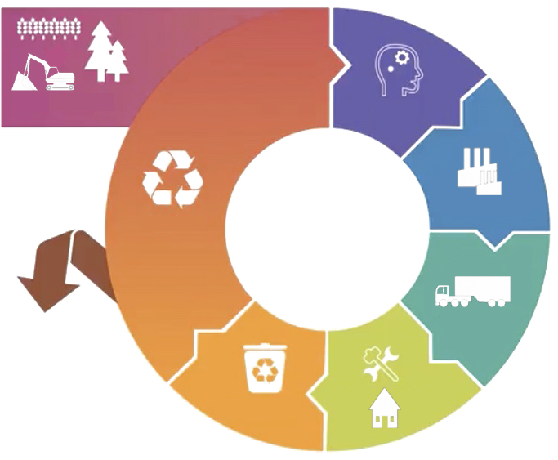
Application in Further Education
Reflection & Feedback
Consider and record how you have incorporated CE into your units.
Feedback session to be arranged in 6 months time…
Circular Economy
and the Construction Sector
Notes:
There is a keenness to reflect back on this in 6 months time. What have we done or what are we doing to incorporate the principles of the Circular Economy into our educational material.

Slide 8
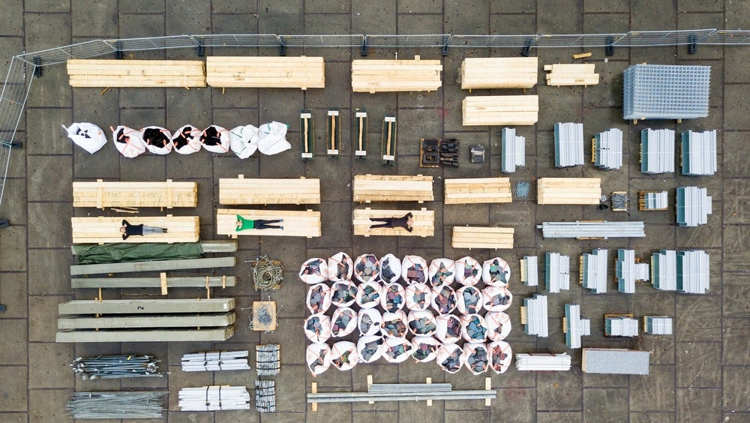
Further Reading…
Notes:
Further Reading for yourselves or your students…

Slide 9
Circular Economy
Further Reading
Source Information:
Zero Waste Scotland: https://www.zerowastescotland.org.uk/
Resource Efficient Scotland: https://www.resourceefficientscotland.com/
Ellen MacArthur Foundation: https://www.ellenmacarthurfoundation.org/
Circular Economy Strategy for Scotland: https://www.gov.scot/publications/making-things-last-circular-economy-strategy-scotland/
Green Building Council: https://www.ukgbc.org/ukgbc-work/circular-economy/
Supply Chain School: https://www.supplychainschool.co.uk/uk/sustainability/construction/issues/waste/circular-economy.aspx
WRAP (embodied carbon): https://www.wrap.org.uk/sites/files/wrap/FINAL%20PRO095-009%20Embodied%20Carbon%20Annex.pdf
Circular Economy
and the Construction Sector

Slide 10
Circular Economy
Further Reading
Precedents / Products:
CE Accelerator: https://ceaccelerator.zerowastescotland.org.uk/circular-stories/
Resource Efficient House: https://www.resourceefficientscotland.com/case-study/resource-efficient-house-demonstration-construction-project
Indinature: https://www.indinature.co
Materials Library: https://materials.ads.org.uk/
Kenoteq: https://kenoteq.com
Waste House: http://arts.brighton.ac.uk/staff/duncan-baker-brown/the-brighton-waste-house
Portal: https://www.cs-ic.org/innovationcentre/innovation-support/online-resources/project-portal/
Dave Cheshire: https://www.aecom.com/uk/press-releases/circular-economy-approach-bring-cost-efficiency-environmental-benefits-built-environment-sector/
Circular Economy
and the Construction Sector

Slide 11
Circular Economy
Further Reading
CPD / Student Training: Become a ‘Green Champion’
Green Champion Training: http://greenchampionsresourceefficientscotland.com/
Circular Economy
and the Construction Sector
Notes:
This provides students with the opportunity to undertake an online module and achieve recognition for completion of the module, which may be of benefit to their CVs.

